Slide 1
Design and Analysis of Algorithms Single-source shortest paths, all-pairs shortest paths

Slide 2
Shortest-Path Problems
Single-source. Find a shortest path from a given source to each of the vertices
Single-pair. Given two vertices, find a shortest path between them. Solution to single-source problem solves this problem efficiently, too
All-pairs. Find shortest-paths for every pair of vertices

Slide 3
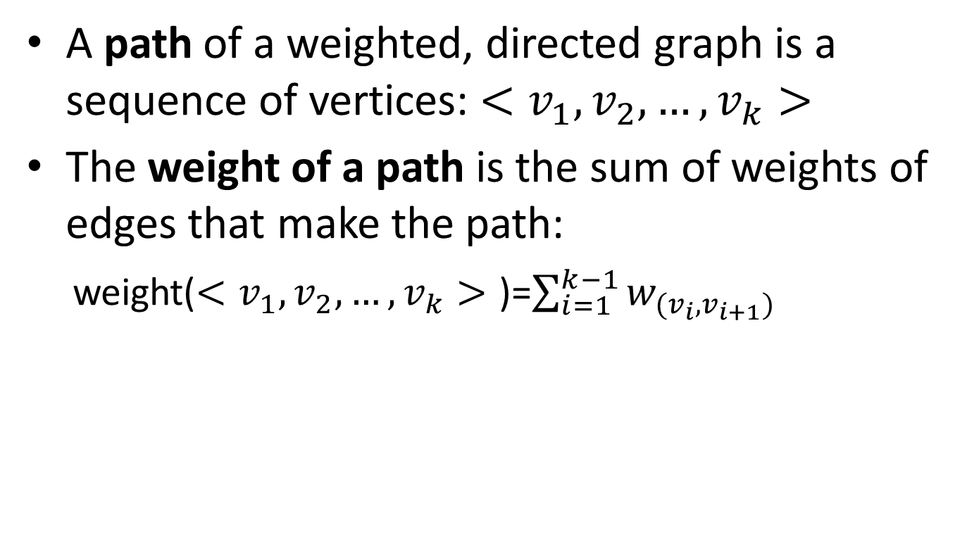
Single-source shortest paths
A path of a weighted, directed graph is a sequence of vertices: $<v_{1},v_{2}, …,v_{k}>$
The weight of a path is the sum of weights of edges that make the path:
weight($<v_{1},v_{2}, …,v_{k}>$ )=$\sum_{i=1}^{k−1}{w_{(v_{i},v_{i+1})}}$

Slide 4
Single-source shortest paths
1
2
3
10
3
2
9
1
6
4
5
7
4
5
2
Given this weighted, directed graph, what is the weight of path: <1, 2, 4>?
10+2=12

Slide 5
Single-source shortest paths
1
2
3
10
3
2
9
1
6
4
5
7
4
5
2
Given this weighted, directed graph, what is the weight of path: <1, 2, 4, 2, 4>?
10+2 + 3 + 2 = 17

Slide 6
Single-source shortest paths
1
2
3
10
3
2
9
1
6
4
5
7
4
5
2
Given this weighted, directed graph, what is the weight of path: <1, 2, 4, 1>?
10 + 2 + $∞$ = $∞$

Slide 7
Single-source shortest paths
1
2
3
10
3
2
9
1
-6
4
5
7
4
5
2
Given this weighted, directed graph, what is the weight of path: <5, 3, 5> and <5, 3, 5, 3, 5>??
4-6 = -2 and -6+4-6+4 = -4
Negative cycle
There is no shortest path from 3 to 5

Slide 8
Single-source shortest paths
Shortest path of a pair of vertices <u, v>: a path from u to v, with minimum path weight
Applications:
Your GPS navigator
If weights are time, it produces the fastest route
If weights are gas cost, it produces the lowest cost route
If weights are distance, it produces the shortest route

Slide 9
Single-source shortest paths
Single-source shortest path problem: given a weighted, directed graph G=(V, E) with source vertex s, find all the shortest (least weight) paths from s to all vertices in V.

Slide 10
Single-source shortest paths
Two classic algorithms to solve single-source shortest path problem
Bellman-Ford algorithm
A dynamic programming algorithm
Works when some weights are negative
Dijkstra’s algorithm
A greedy algorithm
Faster than Bellman-Ford
Works when weights are all non-negative

Slide 11
Bellman-Ford algorithm
Observation:
If there is a negative cycle, there is no solution
Add this cycle again can always produces a less weight path
If there is no negative cycle, a shortest path has at most |V|-1 edges
Idea:
Solve it using dynamic programming
For all the paths have at most 0 edge, find all the shortest paths
For all the paths have at most 1 edge, find all the shortest paths
…
For all the paths have at most |V|-1 edge, find all the shortest paths

Slide 12
NEGATIVE CYCLES
If negative cycles exist in the graph, we’ll say no solution exists. Why?
C
-1
-4
A
B
D
E
2
3
5
What’s the shortest path from A to E?
Is it: A → B → C → D → E? Cost = 2 - 1 - 4 + 5 = 2.

Slide 13
NEGATIVE CYCLES
If negative cycles exist in the graph, we’ll say no solution exists. Why?
C
-1
-4
A
B
D
E
2
3
5
What’s the shortest path from A to E?
Is it: A → B → C → D → E? Cost = 2 - 1 - 4 + 5 = 2.
Or is it: A → B → C → D → B → C → D → B → C → D → B → C → D → B → C → D → E ?
Basically, shortest paths aren’t defined if there are negative cycles!

Slide 14

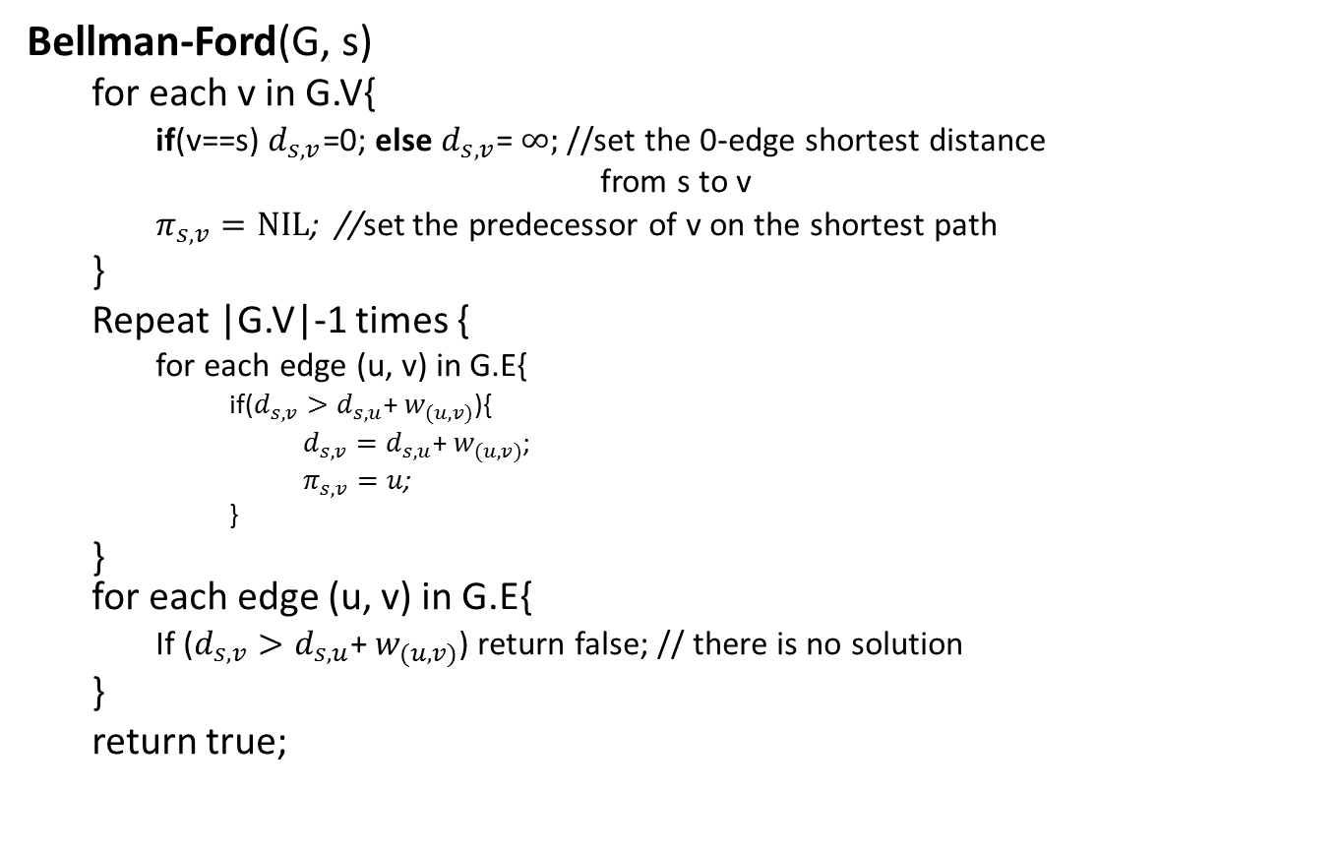
Bellman-Ford PSEUDOCODE 1
Bellman-Ford(G, s)
for each v in G.V{
if(v==s) $d_{s,v}$=0; else $d_{s,v}$= $∞;$//set the 0-edge shortest distance
from s to v
$π_{s,v}=NIL$; //set the predecessor of v on the shortest path
}
Repeat |G.V|-1 times {
for each edge (u, v) in G.E{
if($d_{s,v}>d_{s,u}$+ $w_{(u,v)}$){
$d_{s,v}=d_{s,u}\text{+ }w_{(u,v)}$;
$π_{s,v}=u$;
}
} for each edge (u, v) in G.E{
If ($d_{s,v}>d_{s,u}$+ $w_{(u,v)}$) return false; // there is no solution
}
return true;
//Initialize 0-edge shortest paths
//bottom-up construct 0-to-(|V|-1)-edges shortest paths
//test negative cycle
T(n)=O(VE)=O($V^{3}$)

Slide 15

BELLMAN-FORD PSEUDOCODE 2 (Another Implementation of same algo)
BELLMAN_FORD(G,s):
d^{(k)} = [] for k = 0, ..., n–1
d⁽⁰⁾[v] = ∞ for all v in V (except s)
d⁽⁰⁾[s] = 0
for k = 1, ..., n–1:
for b in V:
d^{(k)}[b] ← min{ d^{(k-1)}[b], min_{a}{d^{(k-1)}[a] + w(a,b)} }
return d^{(n-1)}
Keeping all n–1 rows is a simplification to make the pseudocode straightforward. In practice, we’d only keep 2 of them at a time!
Take the minimum over all incoming neighbors a (i.e. all a s.t. (a, b) ∈ E)
This takes O(deg(b))!!!
CASE 1
CASE 2
Runtime: O(V·E) = > O($V^{3}$)

Slide 16
BELLMAN-FORD
We maintain a list d^{(k)} of length n, for each k = 0, 1, …, n–1.
d^{(k)}[b] = the cost of the shortest path from s to b with at most k edges.
2
s
x
1
2
5
z
y
-2

Slide 17
BELLMAN-FORD
We maintain a list d^{(k)} of length n, for each k = 0, 1, …, n–1.
d^{(k)}[b] = the cost of the shortest path from s to b with at most k edges.
s
x
y
z
0
2
∞
d⁽⁰⁾
0
∞
∞
∞
s
x
1
We know how to fill in d⁽⁰⁾ -- the costs of shortest paths to each vertex with at most k = 0 edges in it
d⁽¹⁾
2
5
d⁽²⁾
z
y
d⁽³⁾
-2
∞
∞

Slide 18
BELLMAN-FORD
We maintain a list d^{(k)} of length n, for each k = 0, 1, …, n–1.
d^{(k)}[b] = the cost of the shortest path from s to b with at most k edges.
s
x
y
z
0
2
∞
d⁽⁰⁾
0
∞
∞
∞
s
x
1
We will use table d⁽⁰⁾ to fill in d⁽¹⁾. More generally, we will use table d^{(k-1)} to fill in d^{(k)}.
d⁽¹⁾
2
5
d⁽²⁾
z
y
d⁽³⁾
-2
∞
∞

Slide 19
BELLMAN-FORD
We maintain a list d^{(k)} of length n, for each k = 0, 1, …, n–1.
d^{(k)}[b] = the cost of the shortest path from s to b with at most k edges.
How do we use d⁽⁰⁾ to update d⁽¹⁾[b]?

Slide 20
BELLMAN-FORD
We maintain a list d^{(k)} of length n, for each k = 0, 1, …, n–1.
d^{(k)}[b] = the cost of the shortest path from s to b with at most k edges.
How do we use d⁽⁰⁾ to update d⁽¹⁾[b]?
Case 1: the shortest path from s to b with at most k edges could be one with at most k–1 edges! In other words, allowing k edges is not going to change anything. Then:
d^{(k)}[b] = d^{(k-1)}[b]

Slide 21
BELLMAN-FORD
We maintain a list d^{(k)} of length n, for each k = 0, 1, …, n–1.
d^{(k)}[b] = the cost of the shortest path from s to b with at most k edges.
How do we use d⁽⁰⁾ to update d⁽¹⁾[b]?
Case 1: the shortest path from s to b with at most k edges could be one with at most k–1 edges! In other words, allowing k edges is not going to change anything. Then:
d^{(k)}[b] = d^{(k-1)}[b]
Case 2: the shortest path from s to b with at most k edges could be one with exactly k edges!

Slide 22
BELLMAN-FORD
We maintain a list d^{(k)} of length n, for each k = 0, 1, …, n–1.
d^{(k)}[b] = the cost of the shortest path from s to b with at most k edges.
How do we use d⁽⁰⁾ to update d⁽¹⁾[b]?
Case 1: the shortest path from s to b with at most k edges could be one with at most k–1 edges! In other words, allowing k edges is not going to change anything. Then:
d^{(k)}[b] = d^{(k-1)}[b]
Case 2: the shortest path from s to b with at most k edges could be one with exactly k edges! I.e. this length-k shortest path is [length k–1 shortest path to some incoming neighbor a] + w(a,b). Which of b’s incoming neighbors will offer this shortest path? Let’s check them all:
d^{(k)}[b] = min_{a in b’s incoming neighbors}{ d^{(k-1)}[a] + w(a,b) }

Slide 23
BELLMAN-FORD
We store a list d^{(k)} of length n, for each k = 0, 1, …, n–1.
d^{(k)}[b] = cost of shortest path from s to b w/ at most k edges.
for k = 1, ..., n–1:
for b in V:
d^{(k)}[b] ← min{d^{(k-1)}[b], min_{a}{d^{(k-1)}[a] + w(a,b)}}
s
x
y
z
0
2
∞
d⁽⁰⁾
0
∞
∞
∞
s
x
1
We will use table d⁽⁰⁾ to fill in d⁽¹⁾. More generally, we will use table d^{(k-1)} to fill in d^{(k)}.
d⁽¹⁾
2
5
d⁽²⁾
z
y
d⁽³⁾
-2
∞
∞

Slide 24
BELLMAN-FORD
We store a list d^{(k)} of length n, for each k = 0, 1, …, n–1.
d^{(k)}[b] = cost of shortest path from s to b w/ at most k edges.
for k = 1, ..., n–1:
for b in V:
d^{(k)}[b] ← min{d^{(k-1)}[b], min_{a}{d^{(k-1)}[a] + w(a,b)}}
s
x
y
z
0
2
∞
d⁽⁰⁾
0
∞
∞
∞
s
x
1
This is min of:
d⁽⁰⁾[s] d⁽⁰⁾[x] + w(x, s)
d⁽¹⁾
0
2
5
d⁽²⁾
z
y
d⁽³⁾
-2
∞
∞

Slide 25
BELLMAN-FORD
We store a list d^{(k)} of length n, for each k = 0, 1, …, n–1.
d^{(k)}[b] = cost of shortest path from s to b w/ at most k edges.
for k = 1, ..., n–1:
for b in V:
d^{(k)}[b] ← min{d^{(k-1)}[b], min_{a}{d^{(k-1)}[a] + w(a,b)}}
s
x
y
z
0
2
∞
d⁽⁰⁾
0
∞
∞
∞
s
x
1
This is min of:
d⁽⁰⁾[x] d⁽⁰⁾[s] + w(s, x)
d⁽¹⁾
0
2
2
5
d⁽²⁾
z
y
d⁽³⁾
-2
∞
∞

Slide 26
BELLMAN-FORD
We store a list d^{(k)} of length n, for each k = 0, 1, …, n–1.
d^{(k)}[b] = cost of shortest path from s to b w/ at most k edges.
for k = 1, ..., n–1:
for b in V:
d^{(k)}[b] ← min{d^{(k-1)}[b], min_{a}{d^{(k-1)}[a] + w(a,b)}}
s
x
y
z
0
2
∞
d⁽⁰⁾
0
∞
∞
∞
s
x
1
This is min of:
d⁽⁰⁾[y] d⁽⁰⁾[s] + w(s, y)
d⁽⁰⁾[x] + w(x, y)
d⁽¹⁾
0
2
5
2
5
d⁽²⁾
z
y
d⁽³⁾
-2
∞
∞

Slide 27
BELLMAN-FORD
We store a list d^{(k)} of length n, for each k = 0, 1, …, n–1.
d^{(k)}[b] = cost of shortest path from s to b w/ at most k edges.
for k = 1, ..., n–1:
for b in V:
d^{(k)}[b] ← min{d^{(k-1)}[b], min_{a}{d^{(k-1)}[a] + w(a,b)}}
s
x
y
z
0
2
∞
d⁽⁰⁾
0
∞
∞
∞
s
x
1
This is min of:
d⁽⁰⁾[z] d⁽⁰⁾[y] + w(y, z)
d⁽¹⁾
0
2
5
∞
2
5
d⁽²⁾
z
y
d⁽³⁾
-2
∞
∞

Slide 28
BELLMAN-FORD
We store a list d^{(k)} of length n, for each k = 0, 1, …, n–1.
d^{(k)}[b] = cost of shortest path from s to b w/ at most k edges.
for k = 1, ..., n–1:
for b in V:
d^{(k)}[b] ← min{d^{(k-1)}[b], min_{a}{d^{(k-1)}[a] + w(a,b)}}
s
x
y
z
0
2
2
d⁽⁰⁾
0
∞
∞
∞
s
x
1
Now, fill in d⁽²⁾!!!
d⁽¹⁾
0
2
5
∞
2
5
d⁽²⁾
z
y
d⁽³⁾
-2
∞
5

Slide 29
BELLMAN-FORD
We store a list d^{(k)} of length n, for each k = 0, 1, …, n–1.
d^{(k)}[b] = cost of shortest path from s to b w/ at most k edges.
for k = 1, ..., n–1:
for b in V:
d^{(k)}[b] ← min{d^{(k-1)}[b], min_{a}{d^{(k-1)}[a] + w(a,b)}}
s
x
y
z
0
2
2
d⁽⁰⁾
0
∞
∞
∞
s
x
1
This is min of:
d⁽¹⁾[s] d⁽¹⁾[x] + w(x, s)
d⁽¹⁾
0
2
5
∞
2
5
d⁽²⁾
0
z
y
d⁽³⁾
-2
∞
5

Slide 30
BELLMAN-FORD
We store a list d^{(k)} of length n, for each k = 0, 1, …, n–1.
d^{(k)}[b] = cost of shortest path from s to b w/ at most k edges.
for k = 1, ..., n–1:
for b in V:
d^{(k)}[b] ← min{d^{(k-1)}[b], min_{a}{d^{(k-1)}[a] + w(a,b)}}
s
x
y
z
0
2
2
d⁽⁰⁾
0
∞
∞
∞
s
x
1
This is min of:
d⁽¹⁾[x] d⁽¹⁾[s] + w(s, x)
d⁽¹⁾
0
2
5
∞
2
5
d⁽²⁾
0
2
z
y
d⁽³⁾
-2
∞
5

Slide 31
BELLMAN-FORD
We store a list d^{(k)} of length n, for each k = 0, 1, …, n–1.
d^{(k)}[b] = cost of shortest path from s to b w/ at most k edges.
for k = 1, ..., n–1:
for b in V:
d^{(k)}[b] ← min{d^{(k-1)}[b], min_{a}{d^{(k-1)}[a] + w(a,b)}}
s
x
y
z
2
2
2
0
2
d⁽⁰⁾
0
∞
∞
∞
0
s
s
x
x
1
1
This is min of:
d⁽¹⁾[y] d⁽¹⁾[s] + w(s, y)
d⁽¹⁾[x] + w(x, y)
d⁽¹⁾
0
2
5
∞
2
2
5
5
d⁽²⁾
0
2
4
z
z
y
y
-2
d⁽³⁾
-2
∞
∞
5
5

Slide 32
BELLMAN-FORD
We store a list d^{(k)} of length n, for each k = 0, 1, …, n–1.
d^{(k)}[b] = cost of shortest path from s to b w/ at most k edges.
for k = 1, ..., n–1:
for b in V:
d^{(k)}[b] ← min{d^{(k-1)}[b], min_{a}{d^{(k-1)}[a] + w(a,b)}}
s
x
y
z
0
2
2
d⁽⁰⁾
0
∞
∞
∞
s
x
1
This is min of:
d⁽¹⁾[z] d⁽¹⁾[y] + w(y, z)
d⁽¹⁾
0
2
5
∞
2
5
d⁽²⁾
0
2
4
3
z
y
d⁽³⁾
-2
3
5

Slide 33
BELLMAN-FORD
We store a list d^{(k)} of length n, for each k = 0, 1, …, n–1.
d^{(k)}[b] = cost of shortest path from s to b w/ at most k edges.
for k = 1, ..., n–1:
for b in V:
d^{(k)}[b] ← min{d^{(k-1)}[b], min_{a}{d^{(k-1)}[a] + w(a,b)}}
s
x
y
z
0
2
2
d⁽⁰⁾
0
∞
∞
∞
s
x
1
Now, fill in d⁽³⁾!!!
d⁽¹⁾
0
2
5
∞
2
5
d⁽²⁾
0
2
4
3
z
y
d⁽³⁾
-2
3
4

Slide 34
BELLMAN-FORD
We store a list d^{(k)} of length n, for each k = 0, 1, …, n–1.
d^{(k)}[b] = cost of shortest path from s to b w/ at most k edges.
for k = 1, ..., n–1:
for b in V:
d^{(k)}[b] ← min{d^{(k-1)}[b], min_{a}{d^{(k-1)}[a] + w(a,b)}}
s
x
y
z
0
2
2
d⁽⁰⁾
0
∞
∞
∞
s
x
1
This is min of:
d⁽²⁾[s] d⁽²⁾[x] + w(x, s)
d⁽¹⁾
0
2
5
∞
2
5
d⁽²⁾
0
2
4
3
z
y
d⁽³⁾
0
-2
3
4

Slide 35
BELLMAN-FORD
We store a list d^{(k)} of length n, for each k = 0, 1, …, n–1.
d^{(k)}[b] = cost of shortest path from s to b w/ at most k edges.
for k = 1, ..., n–1:
for b in V:
d^{(k)}[b] ← min{d^{(k-1)}[b], min_{a}{d^{(k-1)}[a] + w(a,b)}}
s
x
y
z
0
2
2
d⁽⁰⁾
0
∞
∞
∞
s
x
1
This is min of:
d⁽²⁾[x] d⁽²⁾[s] + w(s, x)
d⁽¹⁾
0
2
5
∞
2
5
d⁽²⁾
0
2
4
3
z
y
d⁽³⁾
0
2
-2
3
4

Slide 36
BELLMAN-FORD
We store a list d^{(k)} of length n, for each k = 0, 1, …, n–1.
d^{(k)}[b] = cost of shortest path from s to b w/ at most k edges.
for k = 1, ..., n–1:
for b in V:
d^{(k)}[b] ← min{d^{(k-1)}[b], min_{a}{d^{(k-1)}[a] + w(a,b)}}
s
x
y
z
2
2
2
0
2
d⁽⁰⁾
0
∞
∞
∞
0
s
s
x
x
1
1
This is min of:
d⁽²⁾[y] d⁽²⁾[s] + w(s, y)
d⁽²⁾[x] + w(x, y)
d⁽¹⁾
0
2
5
∞
2
2
5
5
d⁽²⁾
0
2
4
3
z
z
y
y
-2
d⁽³⁾
0
2
4
-2
∞
3
5
4

Slide 37
BELLMAN-FORD
We store a list d^{(k)} of length n, for each k = 0, 1, …, n–1.
d^{(k)}[b] = cost of shortest path from s to b w/ at most k edges.
for k = 1, ..., n–1:
for b in V:
d^{(k)}[b] ← min{d^{(k-1)}[b], min_{a}{d^{(k-1)}[a] + w(a,b)}}
s
x
y
z
0
2
2
d⁽⁰⁾
0
∞
∞
∞
s
x
1
This is min of:
d⁽²⁾[z] d⁽²⁾[y] + w(y, z)
d⁽¹⁾
0
2
5
∞
2
5
d⁽²⁾
0
2
4
3
z
y
d⁽³⁾
0
2
4
2
-2
3
4

Slide 38
BELLMAN-FORD
We store a list d^{(k)} of length n, for each k = 0, 1, …, n–1.
d^{(k)}[b] = cost of shortest path from s to b w/ at most k edges.
for k = 1, ..., n–1:
for b in V:
d^{(k)}[b] ← min{d^{(k-1)}[b], min_{a}{d^{(k-1)}[a] + w(a,b)}}
s
x
y
z
0
2
2
d⁽⁰⁾
0
∞
∞
∞
s
x
1
We’re done!
We can double check the entry for z in each d^{(i)}:
d⁽¹⁾
0
2
5
∞
2
5
d⁽²⁾
0
2
4
3
z
y
d⁽³⁾
0
2
4
2
-2
2
4

Slide 39



Bellman-Ford Example 2
5
$$∞$$
$$∞$$
All 0 edge shortest paths
2
-2
3
6
-3
0
8
1
7
-4
7
2
4
5
$$∞$$
$$∞$$
9
 | 1 | 2 | 3 | 4 | 5
d | 0 | ∞ | ∞ | ∞ | ∞
π | / | / | / | / | /

Slide 40





Bellman-Ford Example 2
Calculate all at most 1 edge shortest paths
5
$$∞$$
$$/6$$
$$∞$$
/$∞$
2
-2
3
6
-3
0
/0
8
1
7
-4
7
2
4
5
$$∞$$
/$∞$
$$∞$$
/$∞$
/$7$
9
 | 1 | 2 | 3 | 4 | 5
d | 0 | 6 | ∞ | 7 | ∞
π | / | 1 | / | 1 | /

Slide 41
Bellman-Ford Example 2
5
Calculate all at most 2 edges shortest paths
$$/6$$
$$∞$$
/11
6
/4
2
-2
3
6
/0
-3
0
8
1
7
-4
7
2
4
5
7
$$∞$$
/2
/7
9
 | 1 | 2 | 3 | 4 | 5
d | 0 | 6 | 4 | 7 | 2
π | / | 1 | 4 | 1 | 2

Slide 42


Bellman-Ford Example 2
Calculate all at most 3 edges shortest paths
$$/2$$
4
/4
$$/6$$
6
2
-2
3
6
5
-3
/0
0
8
1
7
-4
7
2
4
5
7
2
/2
/7
9
 | 1 | 2 | 3 | 4 | 5
d | 0 | 2 | 4 | 7 | 2
π | / | 3 | 4 | 1 | 2

Slide 43
Bellman-Ford Example 2
Calculate all at most 4 edges shortest paths
5
$$/2$$
4
/4
2
2
-2
3
6
/0
-3
0
8
1
7
-4
7
2
4
5
7
2
/-2
/7
9
 | 1 | 2 | 3 | 4 | 5
d | 0 | 2 | 4 | 7 | -2
π | / | 3 | 4 | 1 | 2

Slide 44
Bellman-Ford Example 2
Final result:
5
2
4
2
-2
3
6
-3
0
8
1
7
-4
7
2
4
5
7
-2
9
What is the shortest path from 1 to 5?
1, 4, 3, 2, 5
What is the shortest path from 1 to 2, 3, and 4?
What is weight of this path?
-2

Slide 45

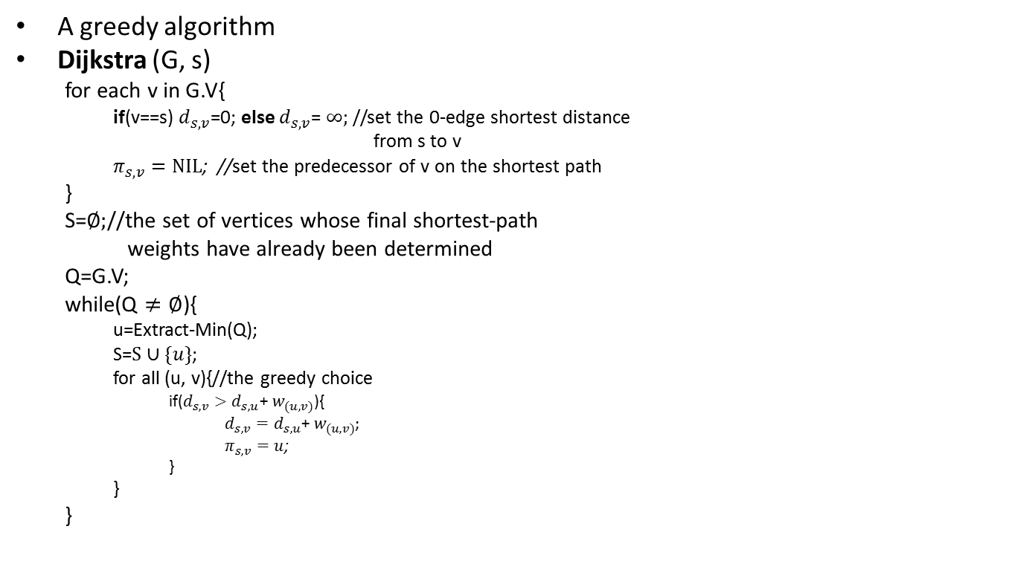
Dijkstra’s Algorithm
A greedy algorithm
Dijkstra (G, s)
for each v in G.V{
if(v==s) $d_{s,v}$=0; else $d_{s,v}$= $∞;$//set the 0-edge shortest distance
from s to v
$π_{s,v}=NIL$; //set the predecessor of v on the shortest path
}
S=$∅;$//the set of vertices whose final shortest-path
weights have already been determined
Q=G.V;
while(Q $≠∅$){
u=Extract-Min(Q);
S=$S∪\{u\}$;
for all (u, v){//the greedy choice
if($d_{s,v}>d_{s,u}$+ $w_{(u,v)}$){
$d_{s,v}=d_{s,u}\text{+ }w_{(u,v)}$;
$π_{s,v}=u$;
}
}
}
T(n)=O($V^{2}$)

Slide 46
Dijkstra's algorithm Pseudocode
dist[s] ←0 (distance to source vertex is zero) for all v ∈ V–{s} do dist[v] ←∞ (set all other distances to infinity) S←∅ (S, the set of visited vertices is initially empty) Q←V (Q, the queue initially contains all vertices) while Q ≠∅ (while the queue is not empty) do u ← mindistance(Q,dist) (select the element of Q with the min. distance) S←S ∈{u} (add u to list of visited vertices) for all v ∈ neighbors[u] do
dist[v]= min(dist[v], dist[u] + w(u, v)) (update distance)
return dist

Slide 47
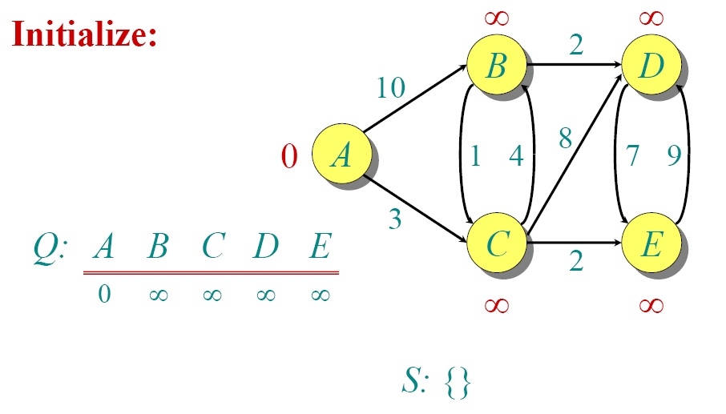
DIJKSTRA EXAMPLE

Slide 48
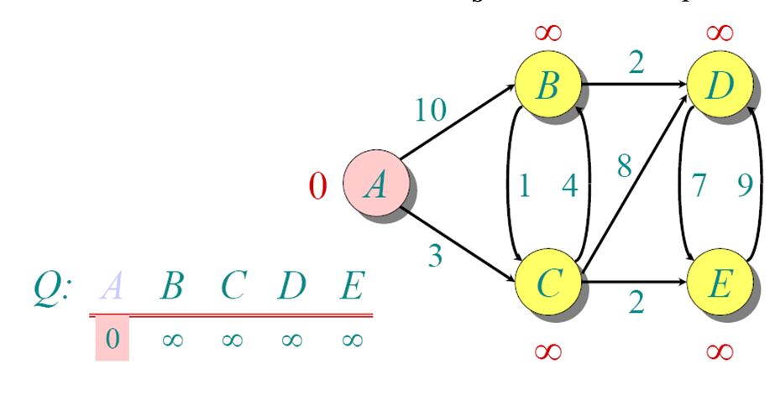
DIJKSTRA EXAMPLE

Slide 49
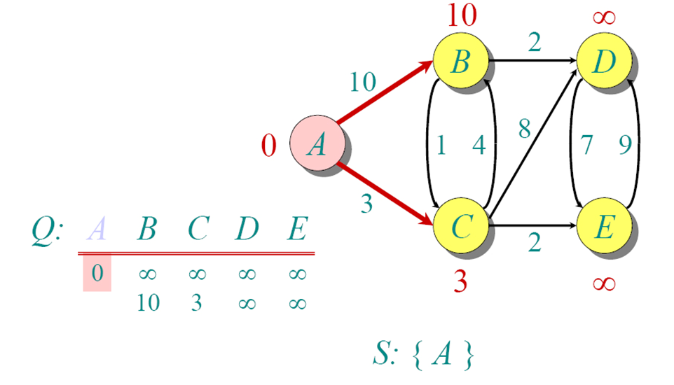
DIJKSTRA EXAMPLE

Slide 50
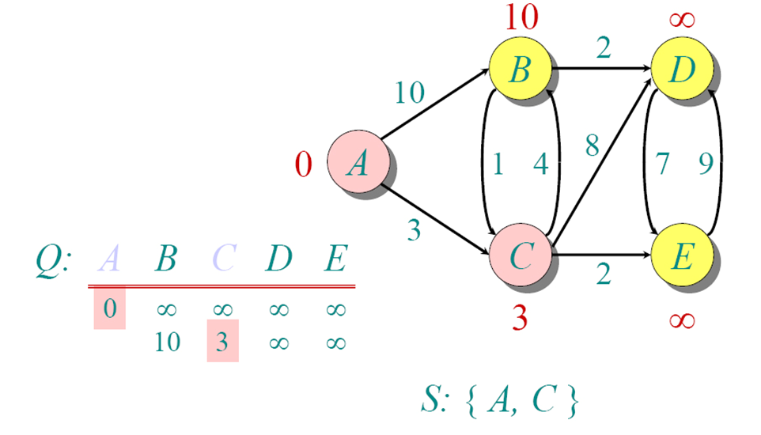
DIJKSTRA EXAMPLE

Slide 51
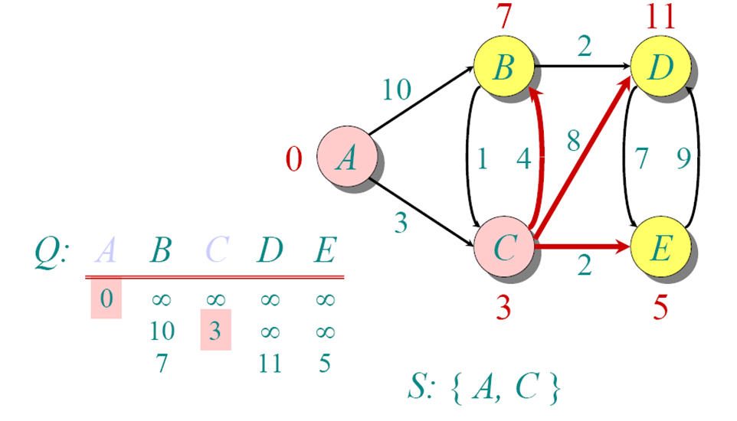
DIJKSTRA EXAMPLE

Slide 52
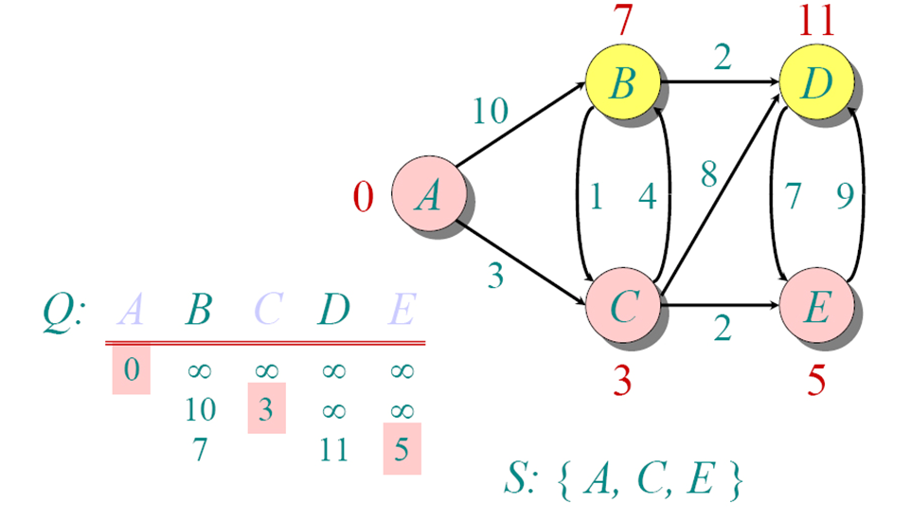
DIJKSTRA EXAMPLE

Slide 53
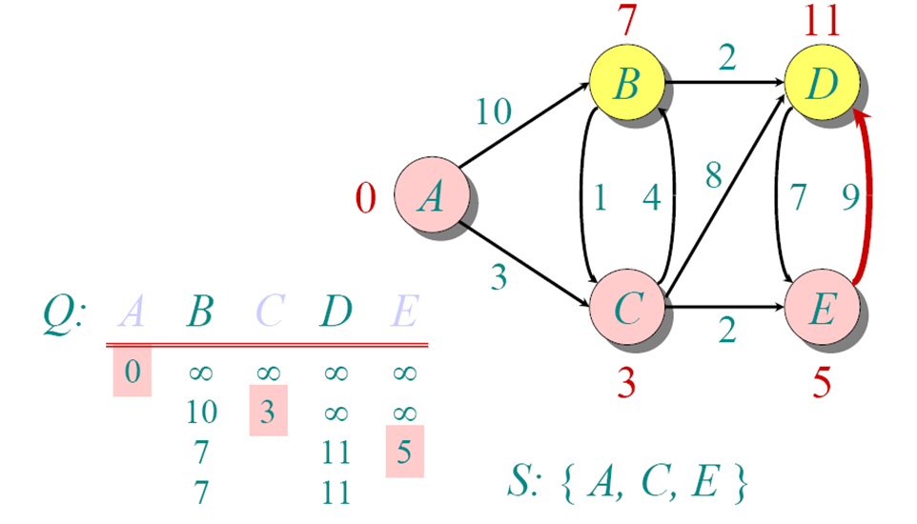
DIJKSTRA EXAMPLE

Slide 54
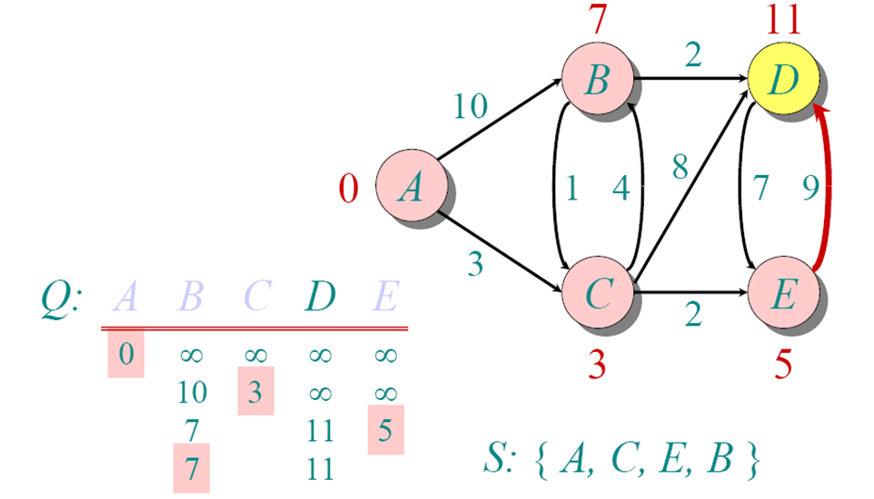
DIJKSTRA EXAMPLE

Slide 55
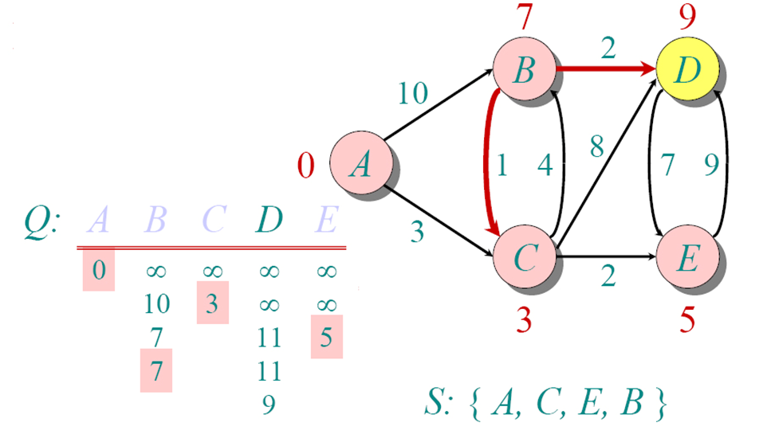
DIJKSTRA EXAMPLE

Slide 56
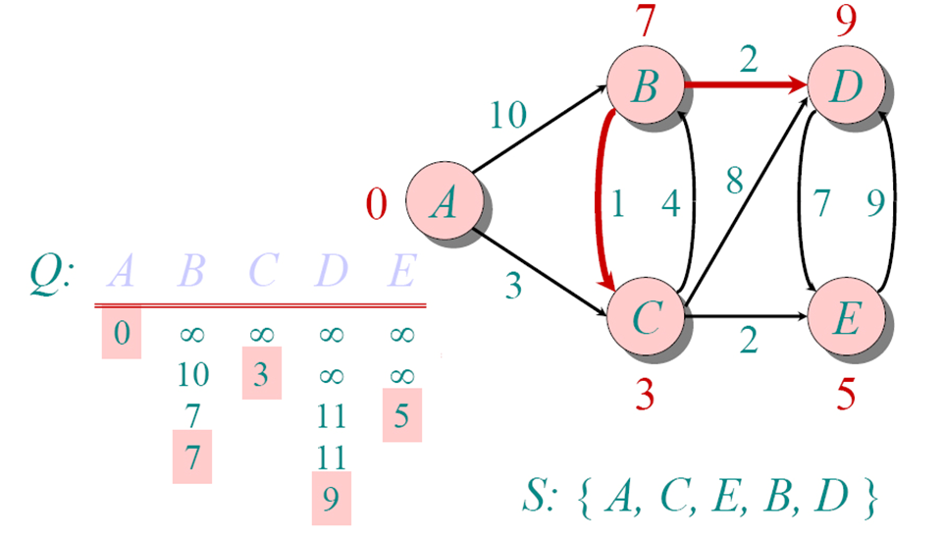
DIJKSTRA EXAMPLE

Slide 57
Dijkstra's algorithm Pseudocode
dist[s] ←0 (distance to source vertex is zero) for all v ∈ V–{s} do dist[v] ←∞ (set all other distances to infinity) S←∅ (S, the set of visited vertices is initially empty) Q←V (Q, the queue initially contains all vertices) while Q ≠∅ (while the queue is not empty) do u ← mindistance(Q,dist) (select the element of Q with the min. distance) S←S ∈{u} (add u to list of visited vertices) for all v ∈ neighbors[u] do if dist[v] min(dist[v], dist[u] + w(u, v)) (update distance)
return dist

Slide 58
Dijkstra’s algorith Running Time
Initialization : Θ(V)
|V| iterations
Each iteration: Θ(V)
Total time: O(V²)

Slide 59
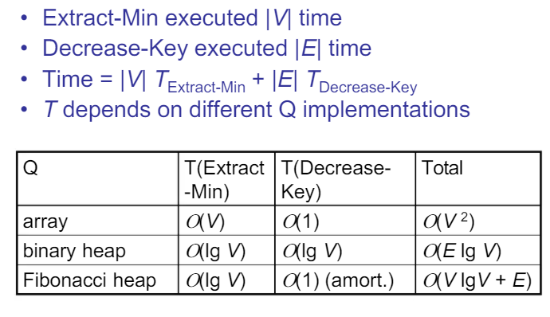
Dijkstra’s algorithm Running Time
Decrease key means: update better (lower) value
Binary heap: O( (V + E) log V)

Slide 60




Dijkstra’s Algorithm
The shortest path of the vertex with smallest distance is determined
1
$$∞$$
$$/10$$
$$∞$$
2
3
10
0
3
2
9
1
6
4
5
7
4
5
$$∞$$
$$/5$$
$$∞$$
2

Slide 61




Dijkstra’s Algorithm
Choose a vertex whose shortest path is now determined
1
10
$$/8$$
$$∞$$
$$/14$$
2
3
10
0
3
2
9
1
6
4
5
7
4
5
$$5$$
$$∞$$
$$/7$$
2

Slide 62



Dijkstra’s Algorithm
Choose a vertex whose shortest path is now determined
1
14
8
$$/13$$
2
3
10
$$/0$$
9
0
3
2
1
6
4
5
7
4
5
$$5$$
$$7$$
2

Slide 63

Dijkstra’s Algorithm
Choose a vertex whose shortest path is now determined
1
$$/9$$
8
13
2
3
10
0
3
2
9
1
6
4
5
7
4
5
$$5$$
$$/5$$
$$7$$
2

Slide 64

Dijkstra’s Algorithm
Choose a vertex whose shortest path is now determined
1
8
9
2
3
10
0
3
2
9
1
6
4
5
7
4
5
$$5$$
$$7$$
$$/7$$
2

Slide 65
Dijkstra’s Algorithm
Final result:
1
8
9
2
3
10
0
3
2
9
1
6
4
5
7
4
5
$$5$$
$$7$$
2
What is the shortest path from 1 to 5?
1, 4, 5
What is the shortest path from 1 to 2, 3, and 4?
What is weight of this path?
7

Slide 66
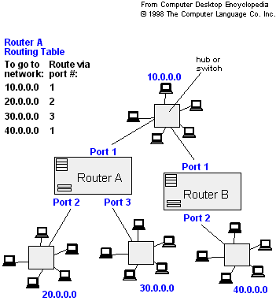
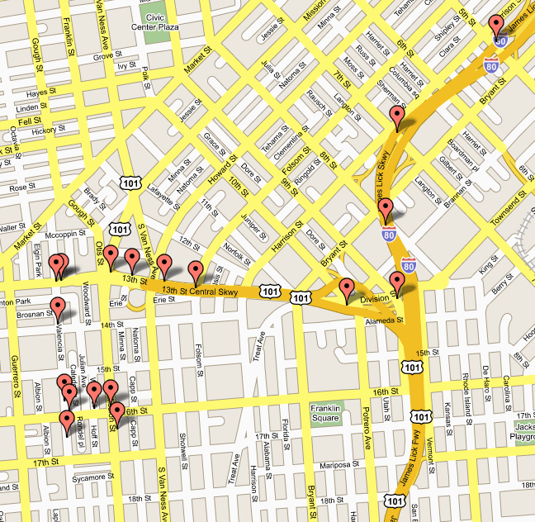
APPLICATIONS
- Traffic Information Systems are most prominent use
- Mapping (Map Quest, Google Maps)
- Routing Systems

Slide 67
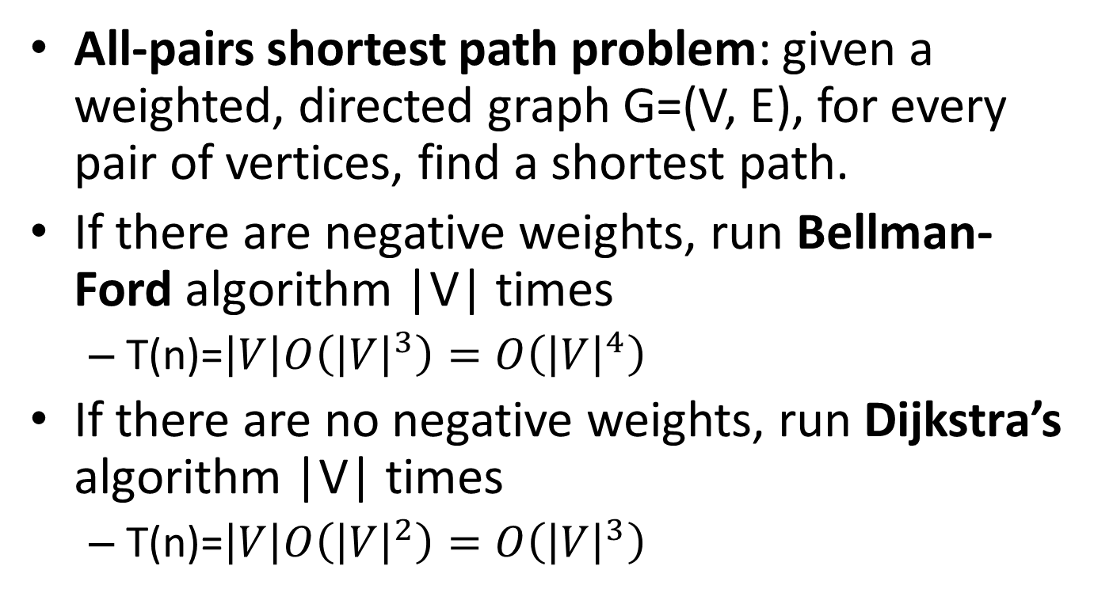
All-pairs shortest paths
All-pairs shortest path problem: given a weighted, directed graph G=(V, E), for every pair of vertices, find a shortest path.
If there are negative weights, run Bellman-Ford algorithm |V| times
T(n)=$\left|V\right|O\left({\left|V\right|}^{3}\right)=O\left({\left|V\right|}^{4}\right)$
If there are no negative weights, run Dijkstra’s algorithm |V| times
T(n)=$\left|V\right|O\left({\left|V\right|}^{2}\right)=O\left({\left|V\right|}^{3}\right)$

Slide 68
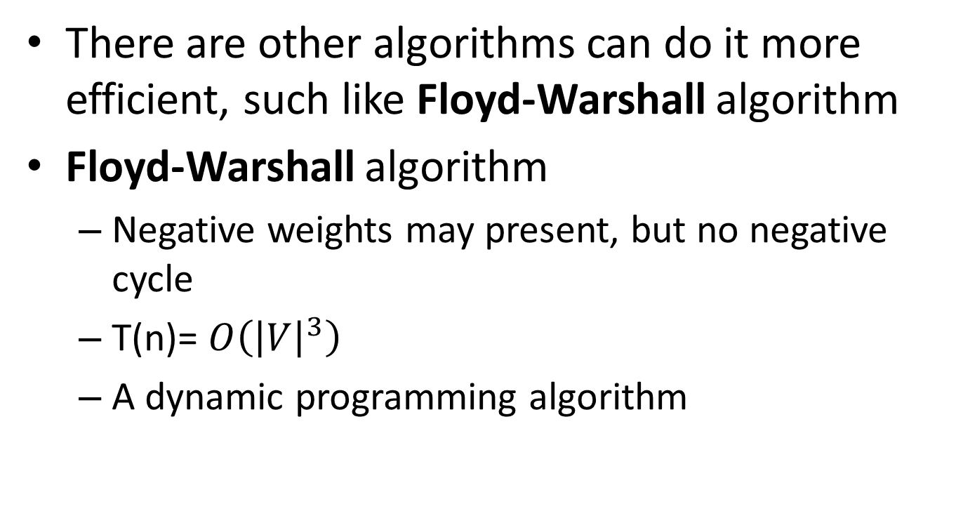
All-pairs shortest paths
There are other algorithms can do it more efficient, such like Floyd-Warshall algorithm
Floyd-Warshall algorithm
Negative weights may present, but no negative cycle
T(n)= $O\left({\left|V\right|}^{3}\right)$
A dynamic programming algorithm

Slide 69
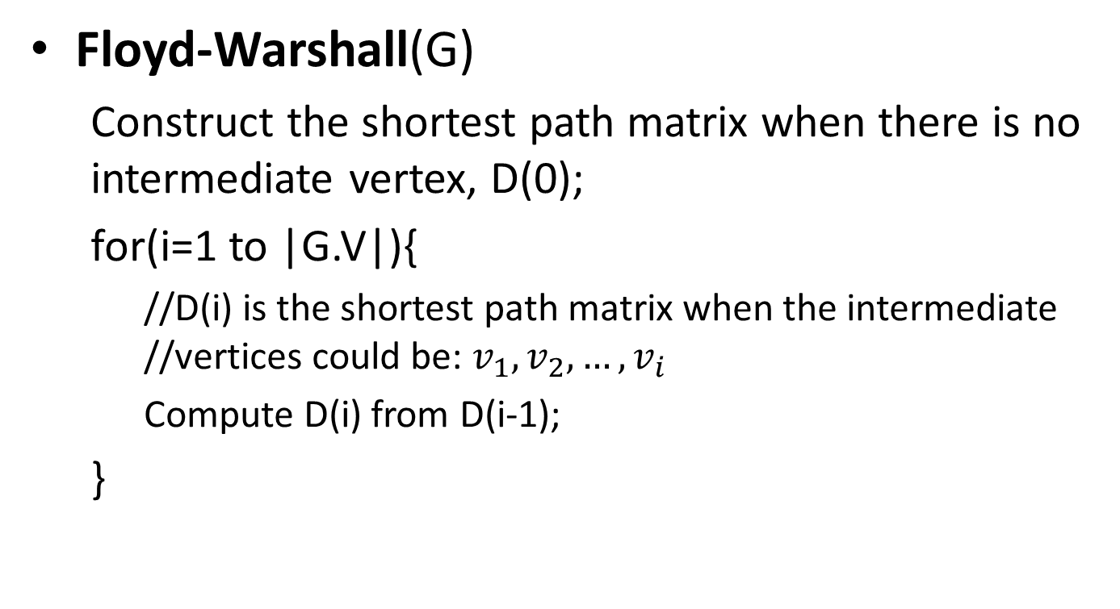
All-pairs shortest paths
Floyd-Warshall(G)
Construct the shortest path matrix when there is no intermediate vertex, D(0);
for(i=1 to |G.V|){
//D(i) is the shortest path matrix when the intermediate //vertices could be: $v_{1},v_{2}, …,v_{i}$
Compute D(i) from D(i-1);
}

Slide 70
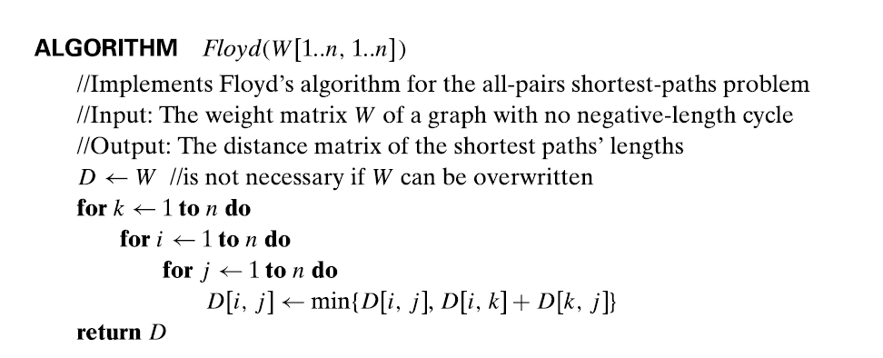
Floyd Algorithm

Slide 71
Floyd-Warshall Algorithm
The Floyd-Warshall algorithm works based on a property of intermediate vertices of a shortest path.

Slide 72
Floyd-Warshall Algorithm

Slide 73
Floyd-Warshall Algorithm

Slide 74
Floyd-Warshall Algorithm

Slide 75
Floyd-Warshall Algorithm

Slide 76
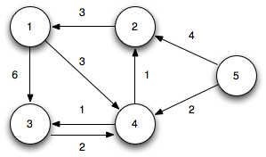
Floyd-Warshall Algorithm
The Floyd-Warshall algorithm works based on a property of intermediate vertices of a shortest path.

Slide 77
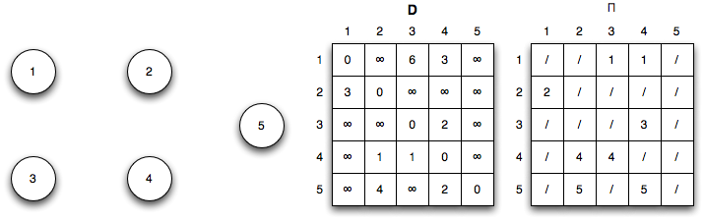
Floyd-Warshall Algorithm
Initialization: (k = 0)

Slide 78
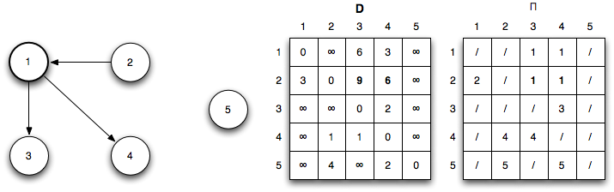
Floyd-Warshall Algorithm
Iteration 1: (k = 1) Shorter paths from 2 ↝ 3 and 2 ↝ 4 are found through vertex 1

Slide 79
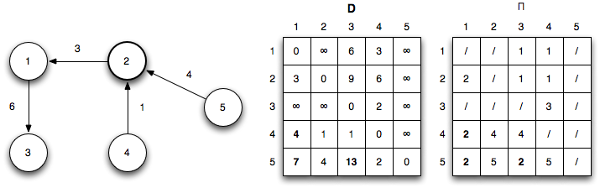
Floyd-Warshall Algorithm
Iteration 2: (k = 2) Shorter paths from 4 ↝ 1, 5 ↝ 1, and 5 ↝ 3 are found through vertex 2

Slide 80
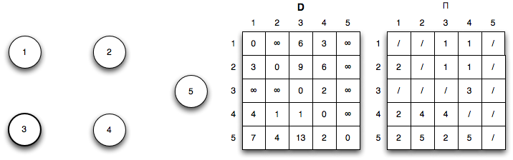
Floyd-Warshall Algorithm
Iteration 3: (k = 3) No shorter paths are found through vertex 3

Slide 81
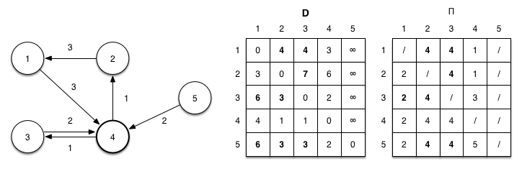
Floyd-Warshall Algorithm
Iteration 4: (k = 4) Shorter paths from 1 ↝ 2, 1 ↝ 3, 2 ↝ 3, 3 ↝ 1, 3 ↝ 2, 5 ↝ 1, 5 ↝ 2, 5 ↝ 3, and 5 ↝ 4 are found through vertex 4

Slide 82
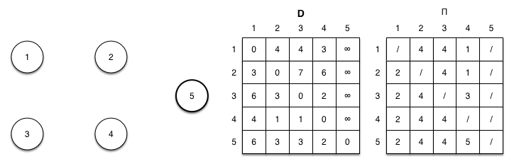
Floyd-Warshall Algorithm
Iteration 5: (k = 5) No shorter paths are found through vertex 5

Slide 83
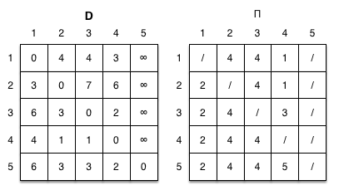
Floyd-Warshall Algorithm
The final shortest paths for all pairs is given by

Slide 84










All-pairs shortest paths
What are the weights of shortest paths with no intermediate vertices, D(0)?
1
2
 | 1 | 2 | 3 | 4
1
2
3
4
9
3
0
$$∞$$
$$∞$$
$$∞$$
6
4
$$∞$$
$$0$$
$$∞$$
4
3
$$9$$
$$0$$
2
3
4
$$∞$$
6
$$∞$$
0
2

Slide 85















All-pairs shortest paths
D(0)
 | 1 | 2 | 3 | 4
1
2
3
4
0
$$∞$$
$$∞$$
$$∞$$
1
2
$$∞$$
0
$$∞$$
4
3
2
0
9
2
$$∞$$
6
$$∞$$
0
3
6
4
What are the weights of shortest paths with intermediate vertex 1?
3
4
D(1)
 | 1 | 2 | 3 | 4
1
2
3
4
9
0
$$∞$$
$$∞$$
$$∞$$
$$∞$$
0
$$∞$$
4
3
$$2$$
0
9
$$∞$$
6
$$∞$$
0

Slide 86












All-pairs shortest paths
D(1)
 | 1 | 2 | 3 | 4
1
2
3
4
0
$$∞$$
$$∞$$
$$∞$$
1
2
$$∞$$
0
$$∞$$
4
3
$$2$$
0
9
2
$$∞$$
6
$$∞$$
0
3
4
6
4
What are the weights of shortest paths with intermediate vertices 1 and 2?
3
4
D(2)
 | 1 | 2 | 3 | 4
1
2
3
4
9
0
$$∞$$
$$∞$$
$$∞$$
$$∞$$
0
$$∞$$
4
3
$$2$$
0
6
$$∞$$
6
$$∞$$
0

Slide 87
















All-pairs shortest paths
D(2)
 | 1 | 2 | 3 | 4
1
2
3
4
0
$$∞$$
$$∞$$
$$∞$$
1
2
$$∞$$
$$∞$$
0
4
3
$$2$$
0
6
2
3
$$∞$$
6
$$∞$$
0
6
4
What are the weights of shortest paths with intermediate vertices 1, 2 and 3?
3
4
D(3)
 | 1 | 2 | 3 | 4
1
2
3
4
9
0
$$∞$$
$$∞$$
$$∞$$
$$∞$$
0
$$∞$$
4
3
$$2$$
0
6
$$∞$$
6
$$∞$$
0

Slide 88





All-pairs shortest paths
D(3)
 | 1 | 2 | 3 | 4
1
2
3
4
0
$$∞$$
$$∞$$
$$∞$$
1
2
$$∞$$
0
$$∞$$
4
3
$$2$$
0
6
2
$$∞$$
6
$$∞$$
0
3
6
4
What are the weights of shortest paths with intermediate vertices 1, 2, 3 and 4?
3
D(4)
4
 | 1 | 2 | 3 | 4
1
2
3
4
9
0
$$∞$$
$$∞$$
$$∞$$
$$∞$$
0
$$∞$$
4
3
$$2$$
0
6
$$∞$$
6
$$∞$$
0

Slide 89
































All-pairs shortest paths
Add predecessor information to reconstruct a shortest path
If updated the predecessor i-j in D(k) is the same as the predecessor k-j in D(k-1)
D(0)
D(1)
 | 1 | 2 | 3 | 4
1
2
3
4
 | 1 | 2 | 3 | 4
1
2
3
4
0/n
$$∞/n$$
$$∞/n$$
$$∞/n$$
0/n
$$∞/n$$
$$∞/n$$
$$∞/n$$
$$∞/n$$
0/n
$$∞/n$$
4/2
$$∞/n$$
0/n
$$∞/n$$
4/2
3/3
$$2/3$$
0/n
9/3
3/3
$$2/3$$
0/n
9/3
$$∞/n$$
6/4
$$∞/n$$
0/n
$$∞/n$$
6/4
$$∞/n$$
0/n
D(2)
D(3)
 | 1 | 2 | 3 | 4
1
2
3
4
 | 1 | 2 | 3 | 4
1
2
3
4
0/n
$$∞/n$$
$$∞/n$$
$$∞/n$$
0/n
$$∞/n$$
$$∞/n$$
$$∞/n$$
$$∞/n$$
0/n
$$∞/n$$
4/2
$$∞/n$$
0/n
$$∞/n$$
4/2
3/3
$$2/3$$
0/n
6/2
3/3
$$2/3$$
0/n
6/2
$$∞/n$$
6/4
$$∞/n$$
0/n
$$∞/n$$
6/4
$$∞/n$$
0/n

Slide 90








All-pairs shortest paths
D(4)
1
2
 | 1 | 2 | 3 | 4
1
2
3
4
0/n
$$∞/n$$
$$∞/n$$
$$∞/n$$
2
$$∞/n$$
4/2
3
$$∞/n$$
0/n
6
4
3/3
$$2/3$$
0/n
6/2
$$∞/n$$
6/4
$$∞/n$$
0/n
3
4
9
What is the shortest path from 3 to 4?
3, 2, 4
What is weight of this path?
6

Slide 91
Remarks
Dijkstra’s algorithm is a single source one
Bellman’s algorithm consider negative weights but for acyclic graphs
Floyd’s algorithm solves for the shortest path among all pairs of vertices.

